Slide 1
Chapter 2b: Operating-System Design and Implementation

Slide 2
Outline
Design and Implementation
Operating System Structure
Building and Booting an Operating System
Operating System Debugging

Slide 3
Objectives
Compare and contrast monolithic, layered, microkernel, modular, and hybrid strategies for designing operating systems
Illustrate the process for booting an operating system
Apply tools for monitoring operating system performance
Design and implement kernel modules for interacting with a Linux kernel

Slide 4
Design and Implementation
Design and Implementation of OS is not “solvable”, but some approaches have proven successful
Internal structure of different Operating Systems can vary widely
Start the design by defining goals and specifications
Affected by choice of hardware, type of system
User goals and System goals
User goals – operating system should be convenient to use, easy to learn, reliable, safe, and fast
System goals – operating system should be easy to design, implement, and maintain, as well as flexible, reliable, error-free, and efficient
Specifying and designing an OS is highly creative task of software engineering

Slide 5
Policy and Mechanism
Policy: What needs to be done?
Example: Interrupt after every 100 seconds
Mechanism: How to do something?
Example: timer
Important principle: separate policy from mechanism
The separation of policy from mechanism is a very important principle, it allows maximum flexibility if policy decisions are to be changed later.
Example: change 100 to 200

Slide 6
Implementation
Much variation
Early OSes in assembly language
Then system programming languages like Algol, PL/1
Now C, C++
Actually usually a mix of languages
Lowest levels in assembly
Main body in C
Systems programs in C, C++, scripting languages like PERL, Python, shell scripts
More high-level language easier to port to other hardware
But slower
Emulation can allow an OS to run on non-native hardware

Slide 7
Operating System Structure
General-purpose OS is very large program
Various ways to structure ones
Simple structure – MS-DOS
More complex – UNIX
Layered – an abstraction
Microkernel – Mach

Slide 8
Monolithic Structure – Original UNIX
UNIX – limited by hardware functionality, the original UNIX operating system had limited structuring.
The UNIX OS consists of two separable parts
Systems programs
The kernel
Consists of everything below the system-call interface and above the physical hardware
Provides the file system, CPU scheduling, memory management, and other operating-system functions; a large number of functions for one level

Slide 9

Traditional UNIX System Structure
Beyond simple but not fully layered

Slide 10

Linux System Structure
Monolithic plus modular design

Slide 11

Layered Approach
The operating system is divided into a number of layers (levels), each built on top of lower layers. The bottom layer (layer 0), is the hardware; the highest (layer N) is the user interface.
With modularity, layers are selected such that each uses functions (operations) and services of only lower-level layers

Slide 12
Microkernels
Moves as much from the kernel into user space
Mach is an example of microkernel
Mac OS X kernel (Darwin) partly based on Mach
Communication takes place between user modules using message passing
Benefits:
Easier to extend a microkernel
Easier to port the operating system to new architectures
More reliable (less code is running in kernel mode)
More secure
Detriments:
Performance overhead of user space to kernel space communication

Slide 13
Microkernel System Structure

Slide 14
Modules
Many modern operating systems implement loadable kernel modules (LKMs)
Uses object-oriented approach
Each core component is separate
Each talks to the others over known interfaces
Each is loadable as needed within the kernel
Overall, similar to layers but with more flexible
Linux, Solaris, etc

Slide 15
Hybrid Systems
Most modern operating systems are not one pure model
Hybrid combines multiple approaches to address performance, security, usability needs
Linux and Solaris kernels in kernel address space, so monolithic, plus modular for dynamic loading of functionality
Windows mostly monolithic, plus microkernel for different subsystem personalities
Apple Mac OS X hybrid, layered, Aqua UI plus Cocoa programming environment
Below is kernel consisting of Mach microkernel and BSD Unix parts, plus I/O kit and dynamically loadable modules (called kernel extensions)

Slide 16
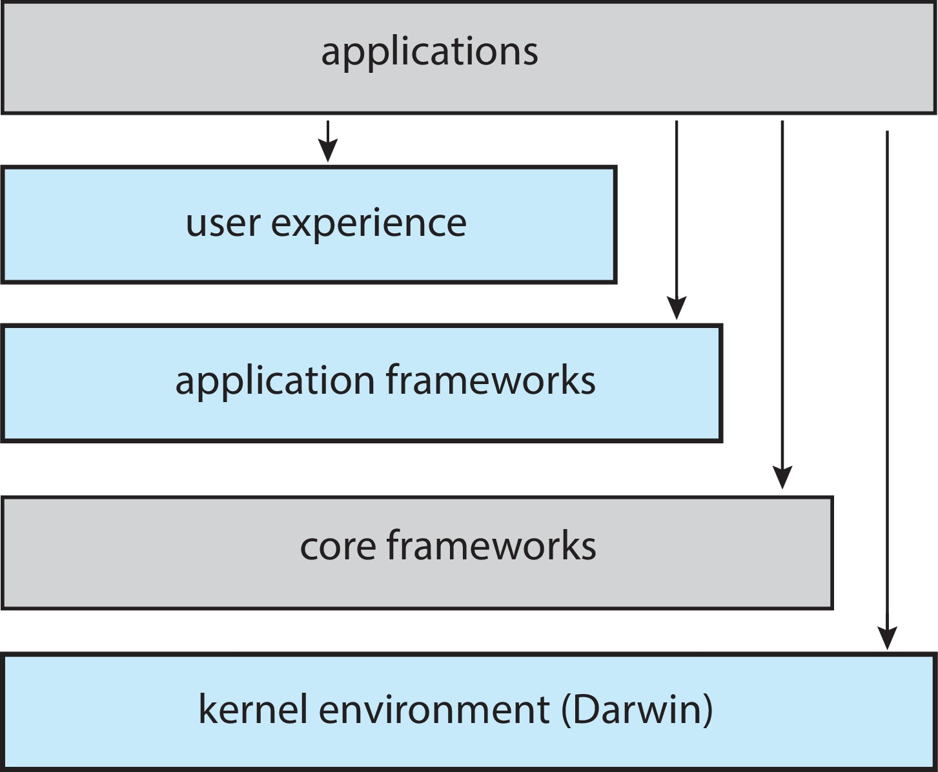
macOS and iOS Structure

Slide 17

Darwin

Slide 18
iOS
Apple mobile OS for iPhone, iPad
Structured on Mac OS X, added functionality
Does not run OS X applications natively
Also runs on different CPU architecture (ARM vs. Intel)
Cocoa Touch Objective-C API for developing apps
Media services layer for graphics, audio, video
Core services provides cloud computing, databases
Core operating system, based on Mac OS X kernel

Slide 19
Android
Developed by Open Handset Alliance (mostly Google)
Open Source
Similar stack to IOS
Based on Linux kernel but modified
Provides process, memory, device-driver management
Adds power management
Runtime environment includes core set of libraries and Dalvik virtual machine
Apps developed in Java plus Android API
Java class files compiled to Java bytecode then translated to executable than runs in Dalvik VM
Libraries include frameworks for web browser (webkit), database (SQLite), multimedia, smaller libc

Slide 20
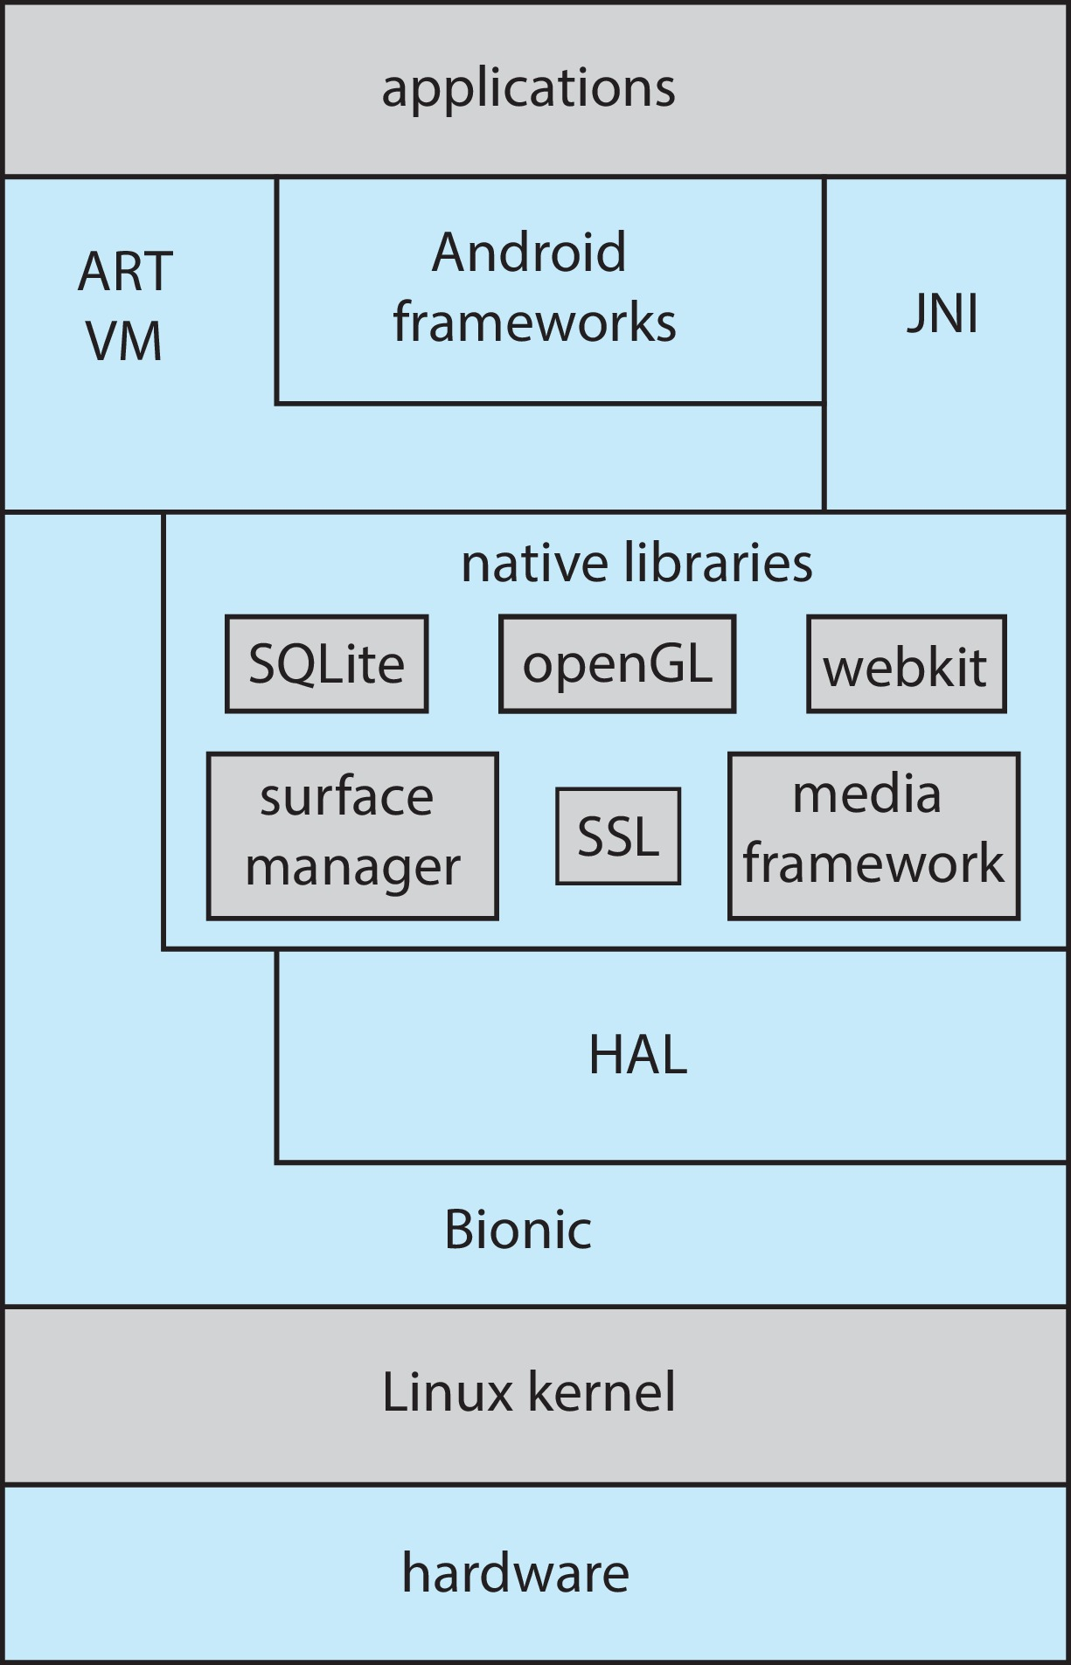
Android Architecture

Slide 21
Building and Booting an Operating System
Operating systems generally designed to run on a class of systems with variety of perpherals
Commonly, operating system already installed on purchased computer
But can build and install some other operating systems
If generating an operating system from scratch
Write the operating system source code
Configure the operating system for the system on which it will run
Compile the operating system
Install the operating system
Boot the computer and its new operating system

Slide 22
Building and Booting Linux
Download Linux source code (http://www.kernel.org)
Configure kernel via “make menuconfig”
Compile the kernel using “make”
Produces vmlinuz, the kernel image
Compile kernel modules via “make modules”
Install kernel modules into vmlinuz via “make modules_install”
Install new kernel on the system via “make install”

Slide 23
System Boot
When power initialized on system, execution starts at a fixed memory location
Operating system must be made available to hardware so hardware can start it
Small piece of code – bootstrap loader, BIOS, stored in ROM or EEPROM locates the kernel, loads it into memory, and starts it
Sometimes two-step process where boot block at fixed location loaded by ROM code, which loads bootstrap loader from disk
Modern systems replace BIOS with Unified Extensible Firmware Interface (UEFI)
Common bootstrap loader, GRUB, allows selection of kernel from multiple disks, versions, kernel options
Kernel loads and system is then running
Boot loaders frequently allow various boot states, such as single user mode

Slide 24
Operating-System Debugging
Debugging is finding and fixing errors, or bugs
Also performance tuning
OS generate log files containing error information
Failure of an application can generate core dump file capturing memory of the process
Operating system failure can generate crash dump file containing kernel memory
Beyond crashes, performance tuning can optimize system performance
Sometimes using trace listings of activities, recorded for analysis
Profiling is periodic sampling of instruction pointer to look for statistical trends
Kernighan’s Law: “Debugging is twice as hard as writing the code in the first place. Therefore, if you write the code as cleverly as possible, you are, by definition, not smart enough to debug it.”

Slide 25
Performance Tuning
Improve performance by removing bottlenecks
OS must provide means of computing and displaying measures of system behavior
For example, “top” program or Windows Task Manager

Slide 26
Tracing
Collects data for a specific event, such as steps involved in a system call invocation
Tools include
strace – trace system calls invoked by a process
gdb – source-level debugger
perf – collection of Linux performance tools
tcpdump – collects network packets

Slide 27

BCC
Debugging interactions between user-level and kernel code nearly impossible without toolset that understands both and an instrument their actions
BCC (BPF Compiler Collection) is a rich toolkit providing tracing features for Linux
See also the original DTrace
For example, disksnoop.py traces disk I/O activity
Many other tools (next slide)

Slide 28
Linux bcc/BPF Tracing Tools

Slide 29
End of Chapter 2b

